Slide 1
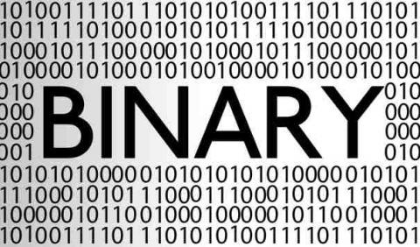
CSE101 Intro to CS and Programming
Number System and Code
Lecture 8 (Week 4)
By Mr. Faheem Shaukat
faheem@iqraisb.edu.pk
www.tinyurl.com/IUICLectures

Slide 2
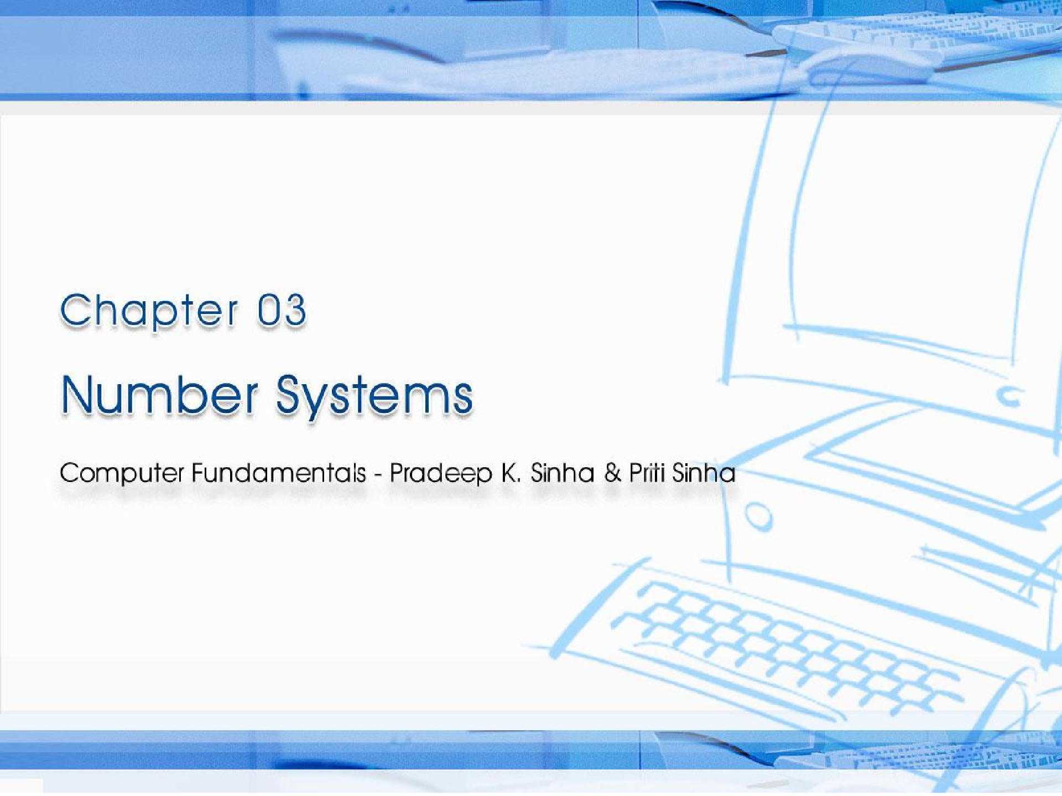
CCoommppuutterer FFununddaammenenttaallss:: PPrradadeeepep KK.. SSiinhanha && PPrriititi SSiinhanha
Ref Page Chapter 3: Number Systems Slide 1/40

Slide 3

Learning Objectives
Computer Fundamentals: Pradeep K. Sinha & Priti Sinha
In this chapter you will learn about:
Non-positional and Positional number system
Decimal number system
Binary number system
Octal number system
Hexadecimal number system
Convert a number’s base
Another base to decimal base
Decimal base to another base
Some base to another base
(Continued on next slide)
Ref Page 20

Slide 4
N u m b e r Systems
Computer Fundamentals: Pradeep K. Sinha & Priti Sinha
Two types of number systems are:
Non-positional number systems
Positional number systems
Ref Page 20

Slide 5
Non-positional Number Systems
Computer Fundamentals: Pradeep K. Sinha & Priti Sinha
Characteristics
Use symbols such as I for 1, II for 2, III for 3, IIII for 4, IIIII for 5, etc
Each symbol represents the same value regardless of its position in the number
The symbols are simply added to find out the value of a particular number
Difficulty
It is difficult to perform arithmetic with such a number system
Ref Page 20

Slide 6
Positional Number Systems
Computer Fundamentals: Pradeep K. Sinha & Priti Sinha
Characteristics
Use only a few symbols called digits
These symbols represent different values depending on the position they occupy in the number
(Continued on next slide)
Ref Page 20

Slide 7
Positional Number Systems
Computer Fundamentals: Pradeep K. Sinha & Priti Sinha
(Continued from previous slide..)
The value of each digit is determined by:
The digit itself
The position of the digit in the number
The base of the number system
(base = total number of digits in the number system)
The maximum value of a single digit is always equal to one less than the value of the base
Ref Page 21

Slide 8
Decimal Number System
Computer Fundamentals: Pradeep K. Sinha & Priti Sinha
Characteristics
A positional number system
▪ Has 10 symbols or digits (0, 1, 2, 3, 4, 5, 6, 7,
8, 9). Hence, its base = 10
The maximum value of a single digit is 9 (one less than the value of the base)
Each position of a digit represents a specific power of the base (10)
We use this number system in our day-to-day life
(Continued on next slide)
Ref Page 21

Slide 9
Decimal Number System
Computer Fundamentals: Pradeep K. Sinha & Priti Sinha
(Continued from previous slide..)
Example
2586₁₀ = (2 x 10³) + (5 x 10²) + (8 x 10¹) + (6 x 10⁰)
= 2000 + 500 + 80 + 6
Ref Page 21

Slide 10
Binary Number System
Computer Fundamentals: Pradeep K. Sinha & Priti Sinha
Characteristics
A positional number system
Has only 2 symbols or digits (0 and 1). base = 2
Hence its
The maximum value of a single digit is 1 (one less than the value of the base)
Each position of a digit represents a specific power of the base (2)
This number system is used in computers
(Continued on next slide)
Ref Page 21

Slide 11
Binary Number System
Computer Fundamentals: Pradeep K. Sinha & Priti Sinha
(Continued from previous slide..)
Example
10101₂ = (1 x 2⁴) + (0 x 2³) + (1 x 2²) + (0 x 2¹) x (1 x 2⁰)
= 16 + 0 + 4 + 0 + 1
= 21₁₀
Ref Page 21

Slide 12
Representing Numbers in Different Number Systems
Computer Fundamentals: Pradeep K. Sinha & Priti Sinha
In order to be specific about which number system we are referring to, it is a common practice to indicate the base as a subscript. Thus, we write:
10101₂ = 21₁₀
Ref Page 21

Slide 13
Computer Fundamentals: Pradeep K. Sinha & Priti Sinha
Bit
Bit stands for binary digit
A bit in computer terminology means either a 0 or a 1
A binary number consisting of n bits is called an n-bit number
Ref Page 22

Slide 14
Octal Number System
Computer Fundamentals: Pradeep K. Sinha & Priti Sinha
Characteristics
A positional number system
Has total 8 symbols or digits (0, 1, 2, 3, 4, 5, 6, 7). Hence, its base = 8
The maximum value of a single digit is 7 (one less than the value of the base
Each position of a digit represents a specific power of the base (8)
(Continued on next slide)
Ref Page 22

Slide 15
Octal Number System
Computer Fundamentals: Pradeep K. Sinha & Priti Sinha
(Continued from previous slide..)
Since there are only 8 digits, 3 bits (2³ = 8) are sufficient to represent any octal number in binary
Example
2057₈
= (2 x 8³) + (0 x 8²) + (5 x 8¹) + (7 x 8⁰)
= 1024 + 0 + 40 + 7
= 1071₁₀
Ref Page 22

Slide 16
Hexadecimal Number System
Computer Fundamentals: Pradeep K. Sinha & Priti Sinha
Characteristics
A positional number system
Has total 16 symbols or digits (0, 1, 2, 3, 4, 5, 6, 7, 8, 9, A, B, C, D, E, F). Hence its base = 16
The symbols A, B, C, D, E and F represent the decimal values 10, 11, 12, 13, 14 and 15 respectively
The maximum value of a single digit is 15 (one less than the value of the base)
(Continued on next slide)
Ref Page 22

Slide 17
Hexadecimal Number System
Computer Fundamentals: Pradeep K. Sinha & Priti Sinha
(Continued from previous slide..)
Each position of a digit represents a specific power of the base (16)
Since there are only 16 digits, 4 bits (2⁴ = 16) are sufficient to represent any hexadecimal number in binary
Example
= (1 x 16²) + (A x 16¹) + (F x 16⁰)
= 1 x 256 + 10 x 16 + 15 x 1
= 256 + 160 + 15
= 431₁₀
1AF₁₆
Ref Page 22

Slide 18
Converting a Number of Another Base to a Decimal Number
Computer Fundamentals: Pradeep K. Sinha & Priti Sinha
Method
Step 1:
Determine the column (positional) value of each digit
Step 2:
Multiply the obtained column values by the digits in the corresponding columns
Step 3:
Calculate the sum of these products
(Continued on next slide)
Ref Page 23

Slide 19
Converting a Number of Another Base to a Decimal Number
Computer Fundamentals: Pradeep K. Sinha & Priti Sinha
(Continued from previous slide..)
Example
4706₈ = ?₁₀
Common values multiplied by the
corresponding digits
4706₈ = 4 x 8³ + 7 x 8² + 0 x 8¹ + 6 x 8⁰
= 4 x 512 + 7 x 64 + 0 + 6 x 1
= 2048 + 448 + 0 + 6
= 2502₁₀
Sum of these products
Ref Page 23

Slide 20
Converting a Decimal Number to a Number of Another Base
Computer Fundamentals: Pradeep K. Sinha & Priti Sinha
Division-Remainder Method
Step 1:
Divide the decimal number to be converted by the value of the new base
Step | 2: | Record the remainder | from Step 1 as | the
 |  | rightmost digit (least | significant digit) of | the
new base number
Step 3:
Divide the quotient of the previous divide by the new base
(Continued on next slide)
Ref Page 25

Slide 21
Converting a Decimal Number to a Number of Another Base
(Continued from previous slide..)
Computer Fundamentals: Pradeep K. Sinha & Priti Sinha
Step 4:
Record the remainder from Step 3 as the next digit (to the left) of the new base number
Repeat Steps 3 and 4, recording remainders from right to left, until the quotient becomes zero in Step 3
Note that the last remainder thus obtained will be the most significant digit (MSD) of the new base number
(Continued on next slide)
Ref Page 25

Slide 22
Converting a Decimal Number to a Number of Another Base
Computer Fundamentals: Pradeep K. Sinha & Priti Sinha
(Continued from previous slide..)
Example
952₁₀ = ?₈
Solution:
8 | 952 | Remainder
 | 119 | ₀
 | 14 | 7
 | 1 | 6
 | 0 | 1
Hence, 952₁₀ = 1670₈
Ref Page 26

Slide 23
Converting a Number of Some Base to a Number of Another Base
Computer Fundamentals: Pradeep K. Sinha & Priti Sinha
Method
Step
1: Convert the original number (base 10)
number
to a decimal
Step 2:
Convert the decimal number so obtained to the new base number
(Continued on next slide)
Ref Page 27

Slide 24
Converting a Number of Some Base of Another Base
Computer Fundamentals: Pradeep K. Sinha & Priti Sinha
to a Number
(Continued from previous slide..)
Example
545₆ = ?₄
Solution:
Step 1: Convert from base 6 to base 10
545₆ = 5 x 6² + 4 x 6¹ + 5 x 6⁰
= 5 x 36 + 4 x 6 + 5 x 1
= 180 + 24 + 5
= 209₁₀
(Continued on next slide)
Ref Page 27

Slide 25
Converting a Number of Some Base of Another Base
Computer Fundamentals: Pradeep K. Sinha & Priti Sinha
to a Number
(Continued from previous slide..)
Step 2:
Convert 209₁₀ to base 4
4 209
Remainders
1
0
1
3
52
13
3
0
Hence, 209₁₀ = 3101₄
So, 545₆ = 209₁₀ = 3101₄
Thus, 545₆ = 3101₄
Ref Page 28

Slide 26
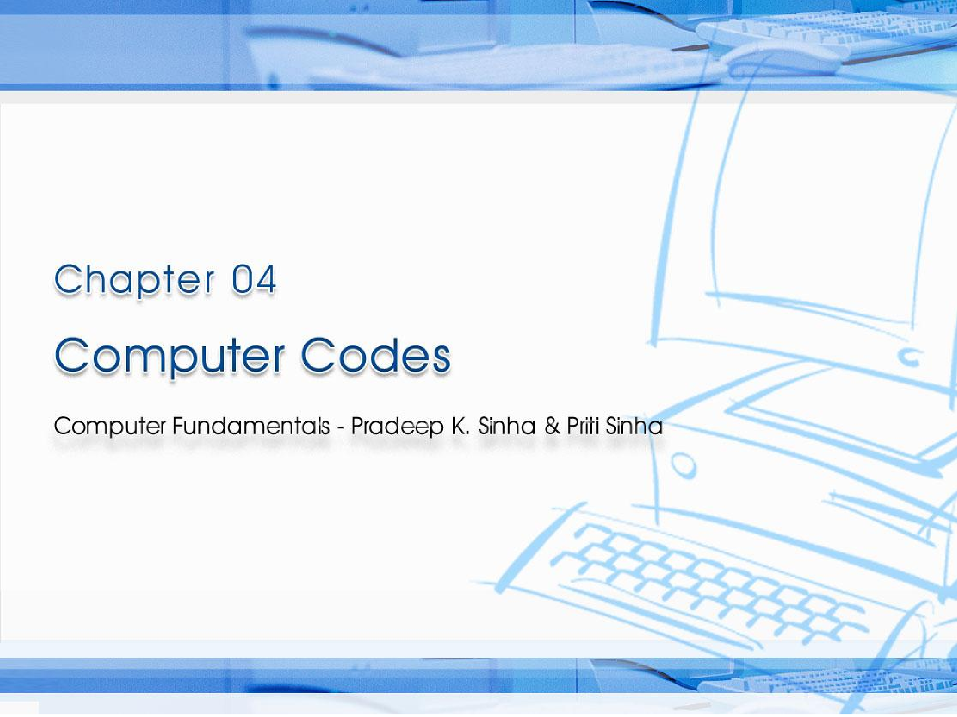
CCoommppuutterer FFununddaammenenttaallss:: PPrradadeeeepp KK.. SSiinhnhaa && PPrriititi SSiinhanha
Ref. Page Chapter 4: Computer Codes Slide 1/30

Slide 27
Learning Objectives
Computer Fundamentals: Pradeep K. Sinha & Priti Sinha
In this chapter you will learn about:
Computer data
Computer codes: representation of data in binary
Most commonly used computer codes
Collating sequence
Ref. Page 36

Slide 28
Data Types
Computer Fundamentals: Pradeep K. Sinha & Priti Sinha
Numeric Data consists of only numbers 0, 1, 2, …, 9
Alphabetic Data consists of only the letters A, B, C,
…, Z, in both uppercase and lowercase, and blank character
Alphanumeric Data is a string of symbols where a symbol may be one of the letters A, B, C, …, Z, in either uppercase or lowercase, or one of the digits 0, 1, 2, …, 9, or a special character, such as + - * / , . (
) = etc.
Ref. Page 36

Slide 29
Computer Codes
Computer Fundamentals: Pradeep K. Sinha & Priti Sinha
Computer codes are used for internal representation of data in computers
As computers use binary numbers for internal data representation, computer codes use binary coding schemes
In binary coding, every symbol that appears in the data is represented by a group of bits
The group of bits used to represent a symbol is called a
byte
(Continued on next slide)
Ref. Page 36

Slide 30
Computer Codes
Computer Fundamentals: Pradeep K. Sinha & Priti Sinha
(Continued from previous slide..)
As most modern coding schemes use 8 bits to represent a symbol, the term byte is often used to mean a group of 8 bits
Commonly used computer codes are BCD, EBCDIC, and ASCII
Ref. Page 36

Slide 31
Computer Fundamentals: Pradeep K. Sinha & Priti Sinha
BCD
BCD stands for Binary Coded Decimal
It is one of the early computer codes
It uses 6 bits to represent a symbol
It can represent 64 (2⁶) different characters
Ref. Page 36

Slide 32
Coding of Alphabetic and Numeric Characters in BCD
Computer Fundamentals: Pradeep K. Sinha & Priti Sinha
Char | BCD Code |  | Octal
 | Zone | Digit
A | 11 | 0001 | 61
B | 11 | 0010 | 62
C | 11 | 0011 | 63
D | 11 | 0100 | 64
E | 11 | 0101 | 65
F | 11 | 0110 | 66
G | 11 | 0111 | 67
H | 11 | 1000 | 70
I | 11 | 1001 | 71
J | 10 | 0001 | 41
K | 10 | 0010 | 42
L | 10 | 0011 | 43
M | 10 | 0100 | 44
Char | BCD Code |  | Octal
 | Zone | Digit
N | 10 | 0101 | 45
O | 10 | 0110 | 46
P | 10 | 0111 | 47
Q | 10 | 1000 | 50
R | 10 | 1001 | 51
S | 01 | 0010 | 22
T | 01 | 0011 | 23
U | 01 | 0100 | 24
V | 01 | 0101 | 25
W | 01 | 0110 | 26
X | 01 | 0111 | 27
Y | 01 | 1000 | 30
Z | 01 | 1001 | 31
(Continued on next slide)
Ref. Page 37

Slide 33
Coding of Alphabetic and Numeric Characters in BCD
(Continued from previous slide..)
Computer Fundamentals: Pradeep K. Sinha & Priti Sinha
Character | BCD Code |  | Octal Equivalent
 | Zone | Digit
1 | 00 | 0001 | 01
2 | 00 | 0010 | 02
3 | 00 | 0011 | 03
4 | 00 | 0100 | 04
5 | 00 | 0101 | 05
6 | 00 | 0110 | 06
7 | 00 | 0111 | 07
8 | 00 | 1000 | 10
9 | 00 | 1001 | 11
0 | 00 | 1010 | 12
Ref. Page 37

Slide 34
EBCDIC
Computer Fundamentals: Pradeep K. Sinha & Priti Sinha
EBCDIC stands for Extended Binary Coded Decimal Interchange Code
It uses 8 bits to represent a symbol
It can represent 256 (2⁸) different characters
Ref. Page 38

Slide 35
Coding of Alphabetic and Numeric Characters in EBCDIC
Computer Fundamentals: Pradeep K. Sinha & Priti Sinha
Char | EBCDIC Code |  | Hex
 | Digit | Zone
A | 1100 | 0001 | C1
B | 1100 | 0010 | C2
C | 1100 | 0011 | C3
D | 1100 | 0100 | C4
E | 1100 | 0101 | C5
F | 1100 | 0110 | C6
G | 1100 | 0111 | C7
H | 1100 | 1000 | C8
I | 1100 | 1001 | C9
J | 1101 | 0001 | D1
K | 1101 | 0010 | D2
L | 1101 | 0011 | D3
M | 1101 | 0100 | D4
Char | EBCDIC Code |  | Hex
 | Digit | Zone
N | 1101 | 0101 | D5
O | 1101 | 0110 | D6
P | 1101 | 0111 | D7
Q | 1101 | 1000 | D8
R | 1101 | 1001 | D9
S | 1110 | 0010 | E2
T | 1110 | 0011 | E3
U | 1110 | 0100 | E4
V | 1110 | 0101 | E5
W | 1110 | 0110 | E6
X | 1110 | 0111 | E7
Y | 1110 | 1000 | E8
Z | 1110 | 1001 | E9
(Continued on next slide)
Ref. Page 39

Slide 36
Coding of Alphabetic and Numeric Characters in EBCDIC
(Continued from previous slide..)
Computer Fundamentals: Pradeep K. Sinha & Priti Sinha
Character | EBCDIC Code |  | Hexadecima l Equivalent
 | Digit | Zone
0 | 1111 | 0000 | F0
1 | 1111 | 0001 | F1
2 | 1111 | 0010 | F2
3 | 1111 | 0011 | F3
4 | 1111 | 0100 | F4
5 | 1111 | 0101 | F5
6 | 1111 | 0110 | F6
7 | 1111 | 0111 | F7
8 | 1111 | 1000 | F8
9 | 1111 | 1001 | F9
Ref. Page 39

Slide 37
ASCII
Computer Fundamentals: Pradeep K. Sinha & Priti Sinha
ASCII stands for American Information Interchange.
Standard
Code for
ASCII is of two types – ASCII-7 and ASCII-8
ASCII-7 uses 7 bits to represent a symbol represent 128 (2⁷) different characters
ASCII-8 uses 8 bits to represent a symbol represent 256 (2⁸) different characters
and can
and can
First 128 characters in ASCII-7 and ASCII-8 are same
Ref. Page 40

Slide 38
Coding of Numeric and Alphabetic Characters in ASCII
Computer Fundamentals: Pradeep K. Sinha & Priti Sinha
Character | ASCII-7 / ASCII-8 |  | Hexadecimal Equivalent
 | Zone | Digit
0 | 0011 | 0000 | 30
1 | 0011 | 0001 | 31
2 | 0011 | 0010 | 32
3 | 0011 | 0011 | 33
4 | 0011 | 0100 | 34
5 | 0011 | 0101 | 35
6 | 0011 | 0110 | 36
7 | 0011 | 0111 | 37
8 | 0011 | 1000 | 38
9 | 0011 | 1001 | 39
(Continued on next slide)
Ref. Page 42

Slide 39
Coding of Numeric and Alphabetic Characters in ASCII
(Continued from previous slide..)
Computer Fundamentals: Pradeep K. Sinha & Priti Sinha
Character | ASCII-7 / ASCII-8 |  | Hexadecimal Equivalent
 | Zone | Digit
A | 0100 | 0001 | 41
B | 0100 | 0010 | 42
C | 0100 | 0011 | 43
D | 0100 | 0100 | 44
E | 0100 | 0101 | 45
F | 0100 | 0110 | 46
G | 0100 | 0111 | 47
H | 0100 | 1000 | 48
I | 0100 | 1001 | 49
J | 0100 | 1010 | 4A
K | 0100 | 1011 | 4B
L | 0100 | 1100 | 4C
M | 0100 | 1101 | 4D
(Continued on next slide)
Ref. Page 42

Slide 40
Coding of Numeric and Alphabetic Characters in ASCII
(Continued from previous slide..)
Computer Fundamentals: Pradeep K. Sinha & Priti Sinha
Character | ASCII-7 / ASCII-8 |  | Hexadecimal Equivalent
 | Zone | Digit
N | 0100 | 1110 | 4E
O | 0100 | 1111 | 4F
P | 0101 | 0000 | 50
Q | 0101 | 0001 | 51
R | 0101 | 0010 | 52
S | 0101 | 0011 | 53
T | 0101 | 0100 | 54
U | 0101 | 0101 | 55
V | 0101 | 0110 | 56
W | 0101 | 0111 | 57
X | 0101 | 1000 | 58
Y | 0101 | 1001 | 59
Z | 0101 | 1010 | 5A
Ref. Page 42

Slide 41
Unicode
Computer Fundamentals: Pradeep K. Sinha & Priti Sinha
Why Unicode:
No single encoding system supports all languages
Different encoding systems conflict
Unicode features:
Provides a consistent way of encoding multilingual plain text
Defines codes for characters used in all major languages of the world
Defines codes for special characters, mathematical symbols, technical symbols, and diacritics
Ref. Page 44

Slide 42
Unicode
Computer Fundamentals: Pradeep K. Sinha & Priti Sinha
Unicode features (continued):
Capacity to encode as many as a million characters
Assigns each character a unique numeric value and name
Reserves a part of the code space for private use
Affords simplicity and consistency of ASCII, even corresponding characters have same code
Specifies an algorithm for the presentation of text with bi-directional behavior
Encoding Forms
▪ UTF-8, UTF-16, UTF-32
Ref. Page 44

